Slide 1
Web/App Performance How to keep you out of the News
Tech Blogs on http://blog.dynatrace.com
Free Tools on http://ajax.dynatrace.com
Hosted by: Jeff Fynboh
Notes:
The Web Performance Optimization (WPO) movement made a huge impact in optimizing the web apps we build. But in 2014 this is no longer enough. With Mobile Apps and Applications that rely on backend services, 3rd party services, distributed across the globe in physical or virtual data centers requires developers to not just focus on web performance in their browser but end-to-end performance of their application

Slide 2
WHY we are here TODAY…

Slide 3
Nobody wants this …

Slide 4
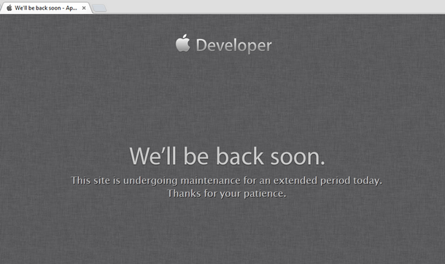
Unless you work for Google or Microsoft ☺

Slide 5
Nor this …

Slide 6
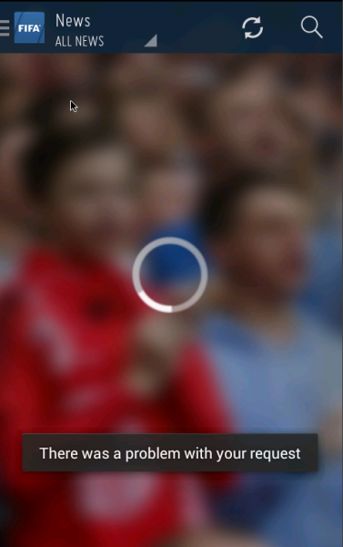
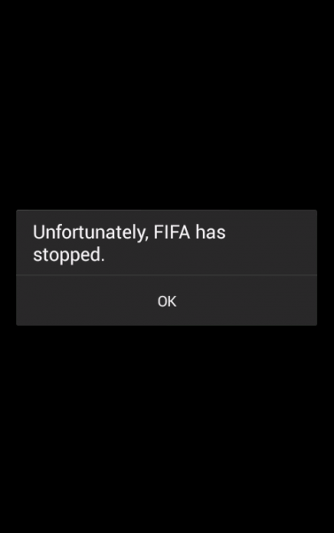

Slide 7
As it leads to this …

Slide 8
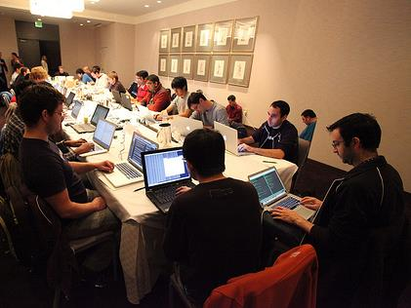
The “War Room”
Facebook – December 2012

Slide 9
And potentially to this …

Slide 10
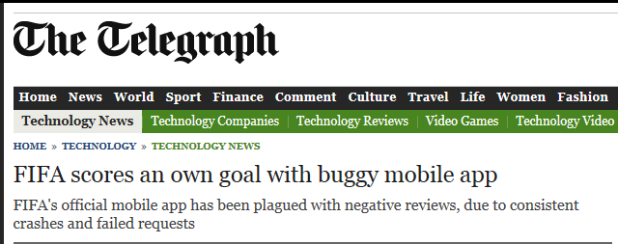
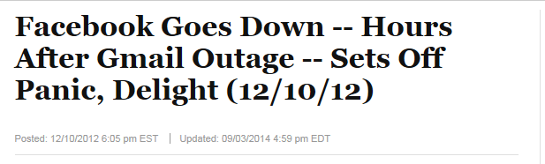

Slide 11
And this …

Slide 12
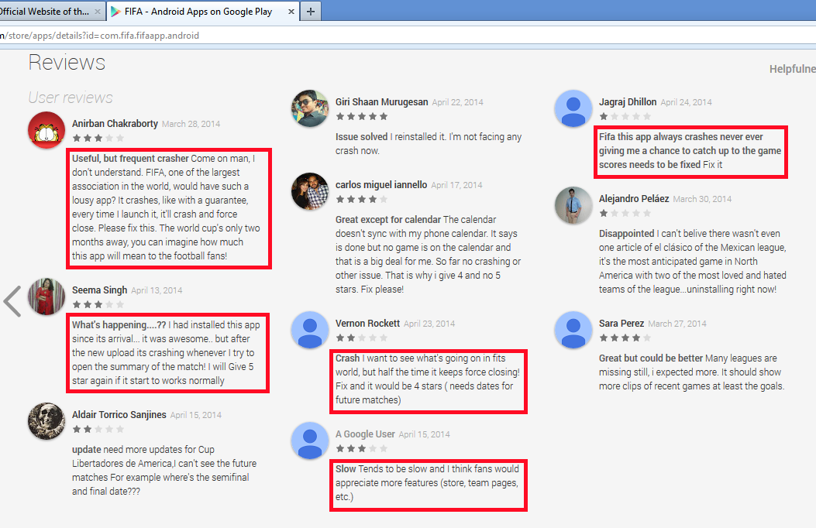

Slide 13
And that’s why Business doesn’t like it either …

Slide 14
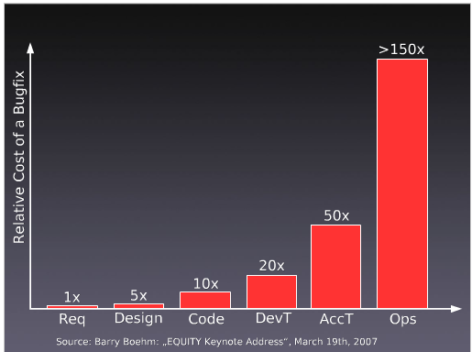
YES we know this
80% Dev Time in Bug Fixing
$60B Defect Costs
BUT
~80% of problems
caused by ~20% patterns

Slide 15
5 Situations on WHY this happened, HOW to avoid it

Slide 16
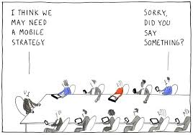

Slide 17
#Push
without a Plan

Slide 18
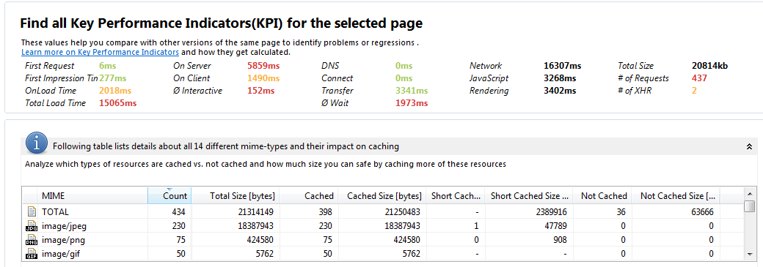
Mobile Landing Page of Super Bowl Ad
Total size of ~ 20MB
434 Resources in total on that page:
230 JPEGs, 75 PNGs, 50 GIFs, …

Slide 19
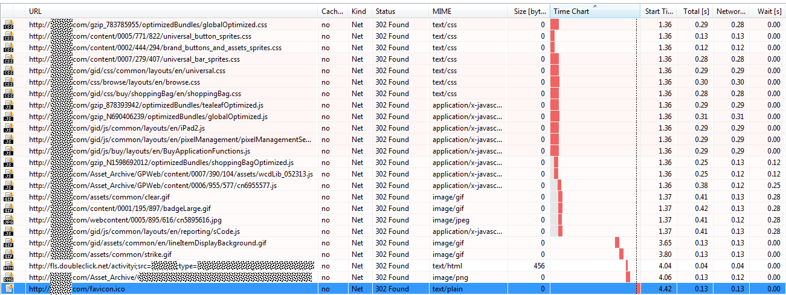
m.store.com redirects to www.store.com
ALL CSS and JS files are redirected to the www domain
This is a lot of time “wasted” especially on high latency mobile connections

Slide 20
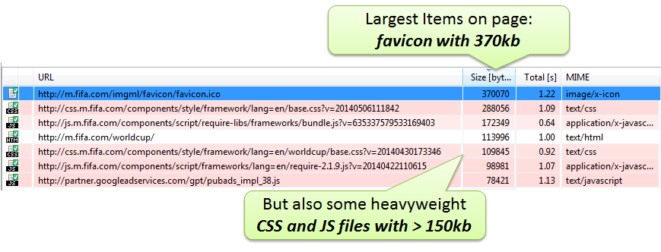
Fifa.com during Worldcup
http://apmblog.compuware.com/2014/05/21/is-the-fifa-world-cup-website-ready-for-the-tournament/

Slide 21
# Images
# Redirects
Size of Resources

Slide 22


Slide 23
#“Blindly” (Re)use Existing Components

Slide 24
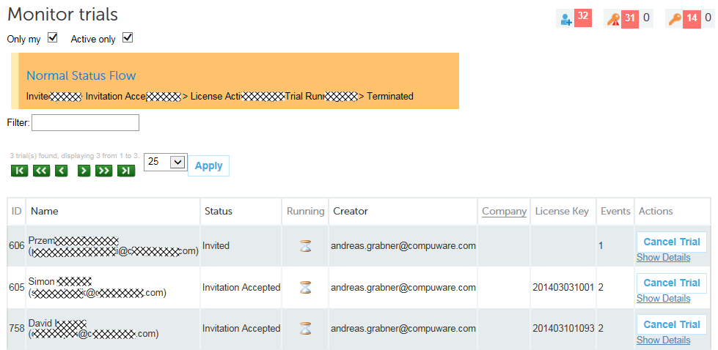
Requirement: We need a report

Slide 25
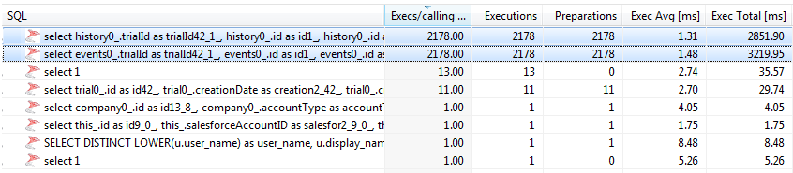
Using Hibernate results in 4k+ SQL Statements to display 3 items!
Hibernate Executes 4k+ Statements
Individual Execution VERY FAST
But Total SUM takes 6s

Slide 26
# SQL Executions
# of SAME SQLs

Slide 27
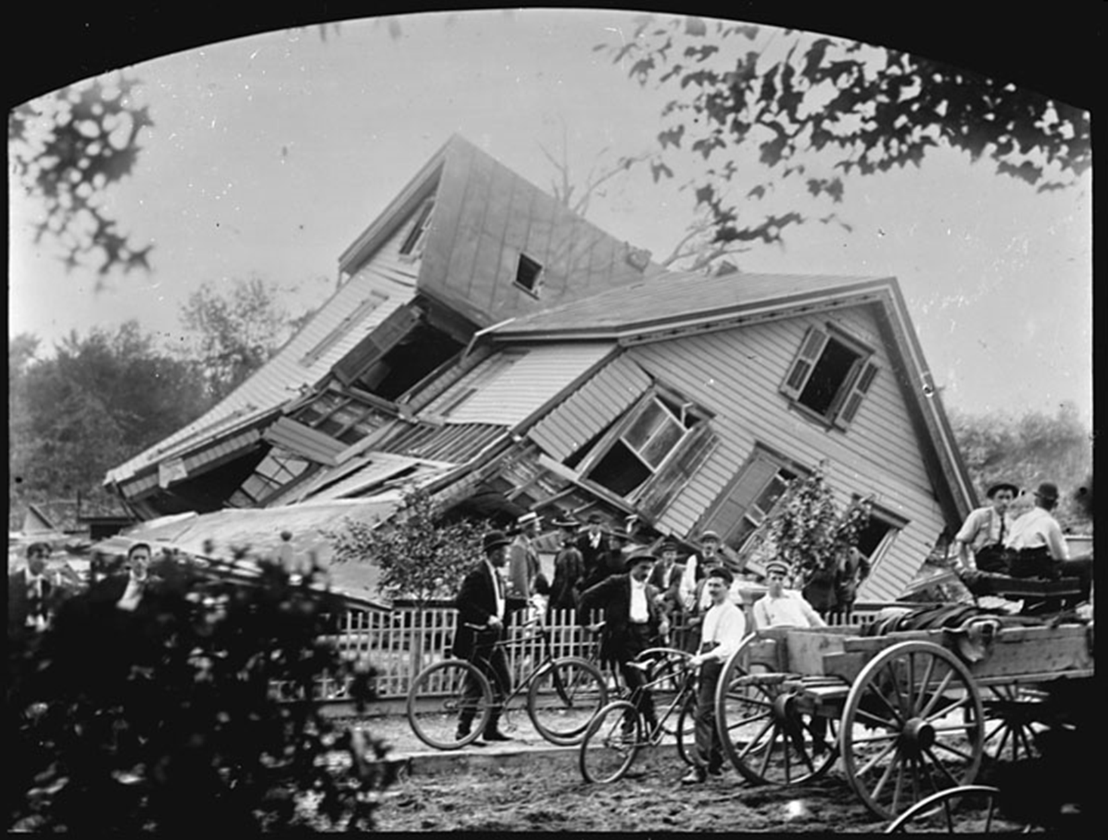

Slide 28
Architectural Decisions gone Bad

Slide 29
Project: Online Room Reservation System
Symptoms
HTML takes between 60 and 120s to render
High GC Time
Developer Assumptions
Bad GC Tuning
Probably bad Database Performance as rendering was simple
Result: 2 Years of Finger pointing between Dev and DBA

Slide 30
Developers built own monitoring
void roomreservationReport(int officeId)
{
long startTime = System.currentTimeMillis();
Object data = loadDataForOffice(officeId);
long dataLoadTime = System.currentTimeMillis() - startTime;
generateReport(data, officeId);
}
Result:
Avg. Data Load Time: 45s!
DB Tool says:
Avg. SQL Query: <1ms!

Slide 31
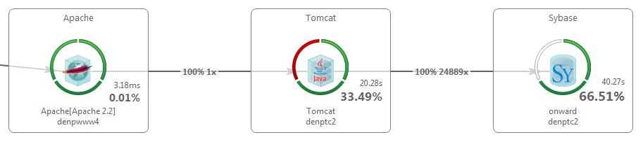
#1: Loading too much data
24889! Calls to the Database API!
High CPU and High Memory Usage to keep all data in Memory

Slide 32
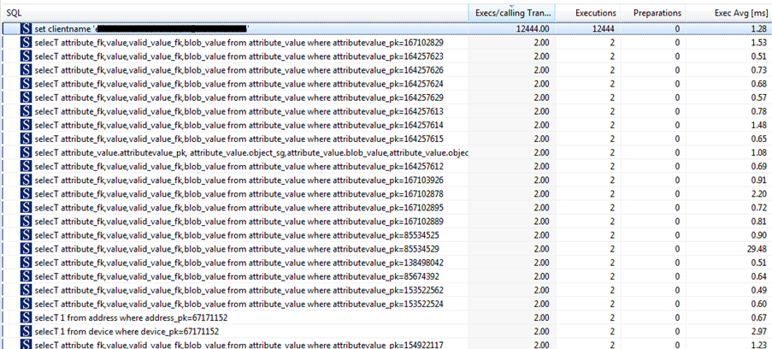
#2: On individual connections
12444! individual connections
Individual SQL really <1ms
Classical N+1 Query Problem

Slide 33
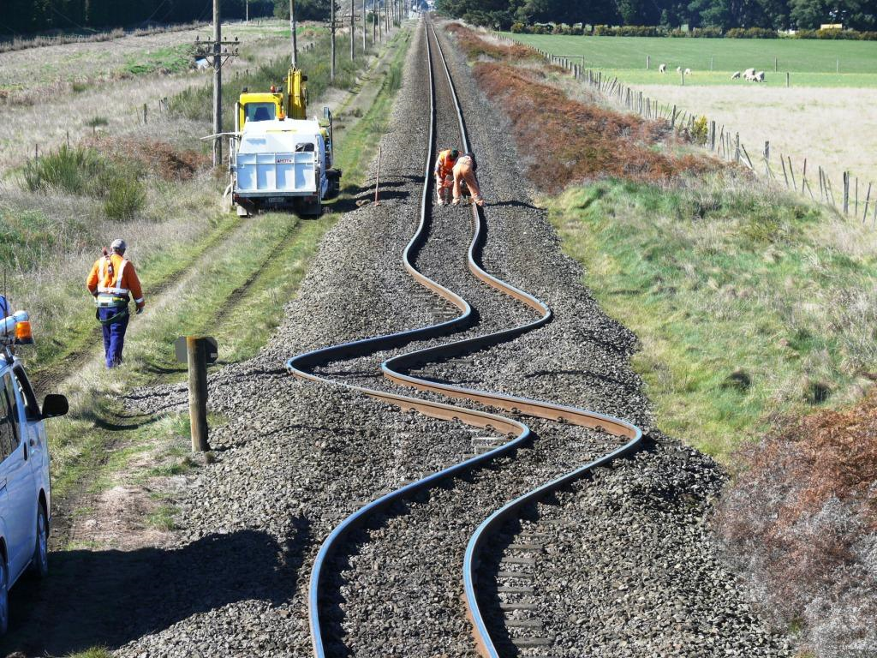

Slide 34
Don’t assume
You know the environment

Slide 35
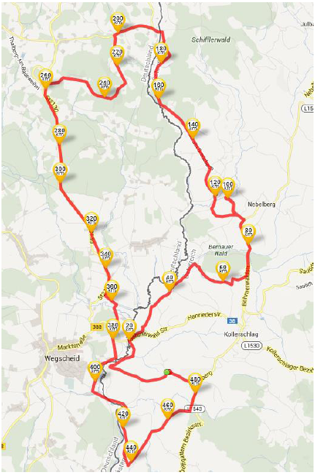
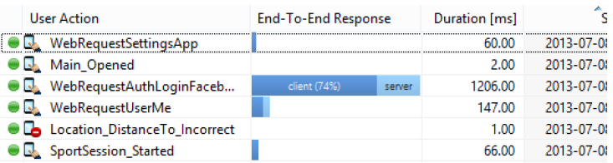
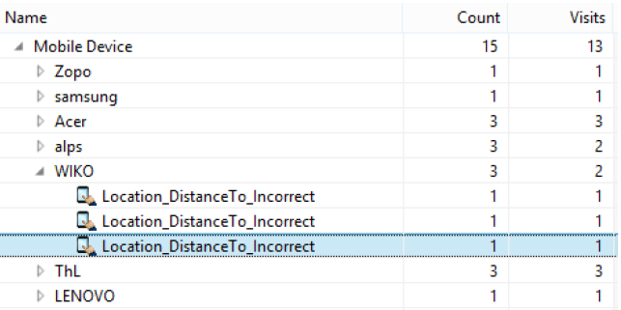
Distance Calculation Issues
Solution: Unit Test in Live App reports Geo Calc Problems
480km biking in 1 hour!
Finding: Only happens on certain Android versions

Slide 36
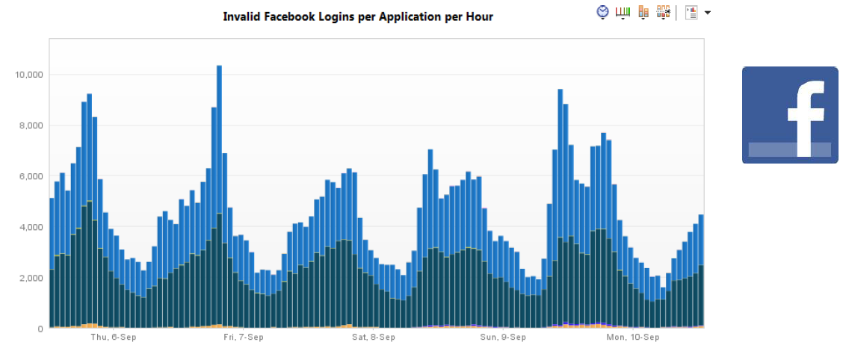
3rd Party Issues
Impact of bad 3rd party calls

Slide 37
# Functional Errors
3rd Party calls

Slide 38


Slide 39
Deployment gone bad

Slide 40
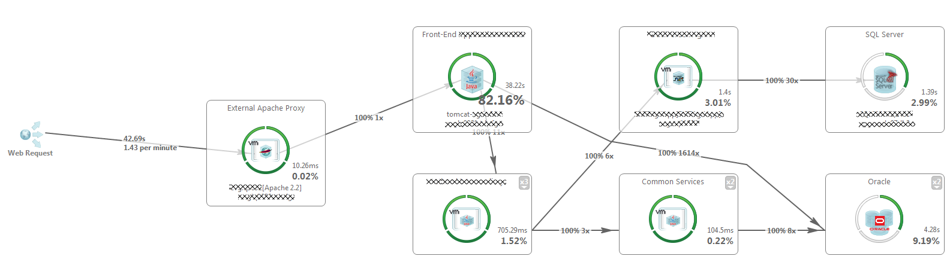
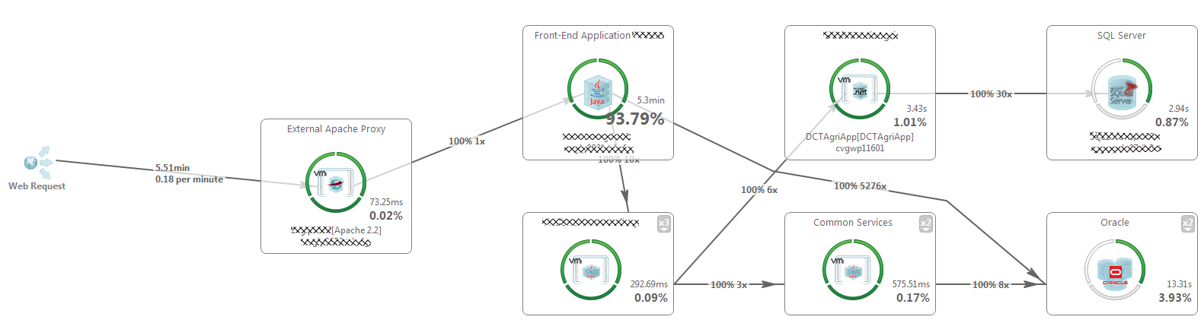
Test Environment
Production Environment
8x slower
3x more SQL

Slide 41
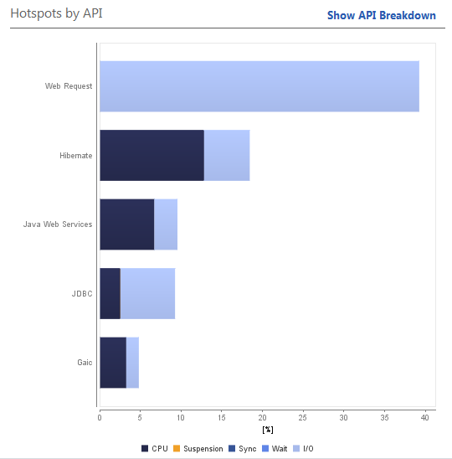
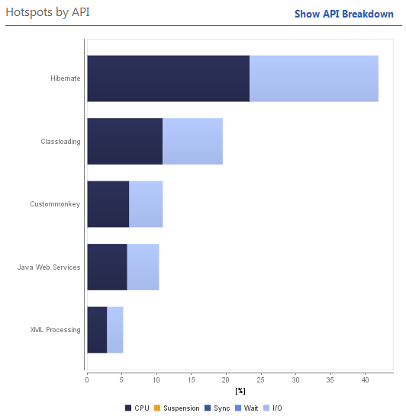
Test Environment
Production Environment
That’s Normal: Having I/O for Web Request as main contributor
Hibernate, Classloading, XML – The Key Hotspots
I/O for Web Requests doesn’t even show up!
Hibernate, Classloading, XML – The Key Hotspots

Slide 42
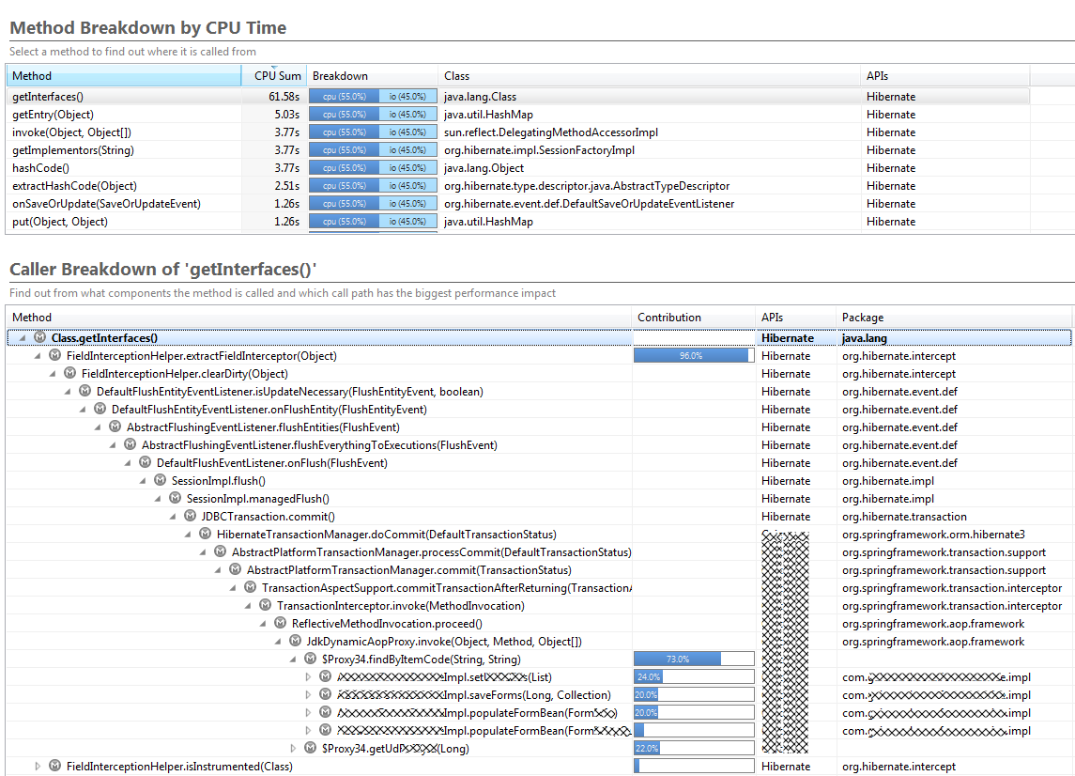
Top Contributor Class.getInterfaces
Called from Hibernates FieldInterceptionHelper
These calls all originate from thousands of calls to find item by code

Slide 43
Time Spent in API
# Calls into API

Slide 44




12 000 000 $

Slide 45
#No “Agile” Deployment

Slide 46
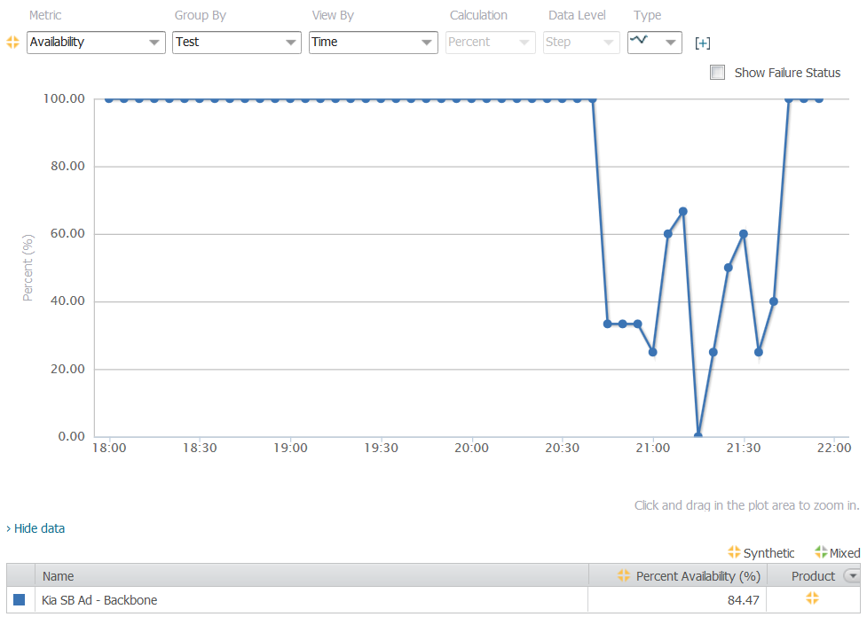
Load Spike resulted in Unavailability
Ad on air
Availability dropped to 0%

Slide 47
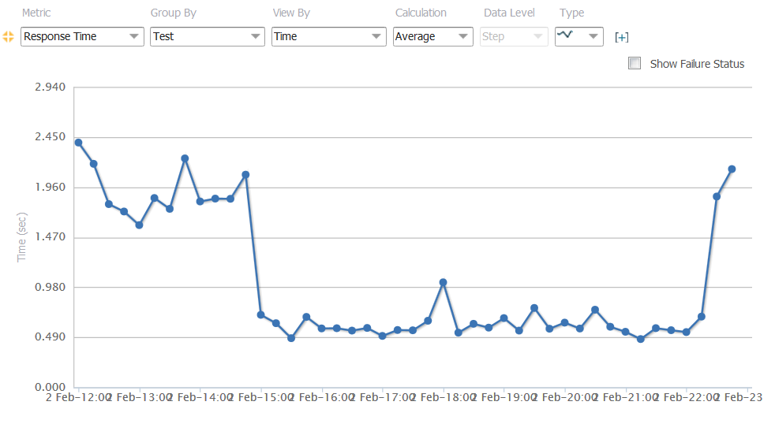
Alternative: “GoDaddy goes DevOps”
Response time improved 4x
1h before
SuperBowl KickOff
1h after
Game ended

Slide 48
# of Domains
Total Size

Slide 49
Consider these Metrics
# Images
# Redirects
Size of Resources
# SQL Executions
# of SAME SQLs
# Items per Page
# AJAX per Page
Time Spent in API
# Calls into API
# Functional Errors
3rd Party calls
# of Domains
Total Size

Slide 50


(R)Evolutionize Web Performance Optimization
Unit & Integration Tests
Performance Tests
Production
Monitoring
Commit Stage
Compile
Execute Unit Test
Code Analysis
Build installers
Automated
Acceptance
Testing
Automated
Capacity
Testing
Manual testing
Key showcases
Exploratory testing
Release
Functional Tests
Functional Tests

Slide 51


Slide 52
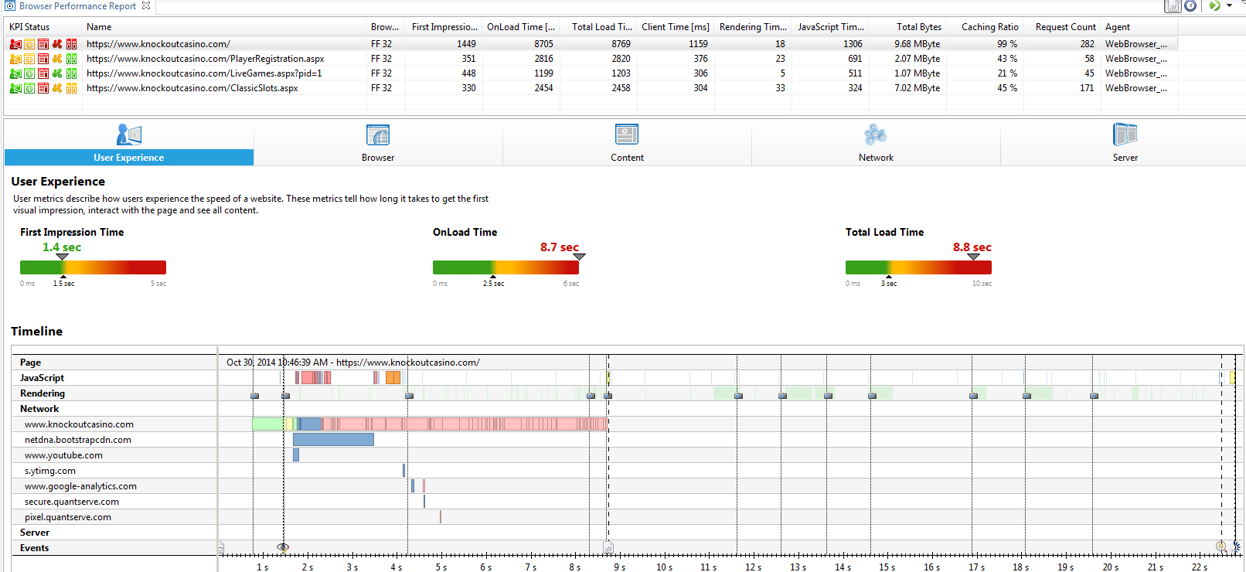
Example from Web Diagnostics
282! Objects on that page
9.68MB Page Size
8.8s Page Load Time
Most objects are images delivered from your main domain
Very long Connect time (1.8s) to your CDN

Slide 53
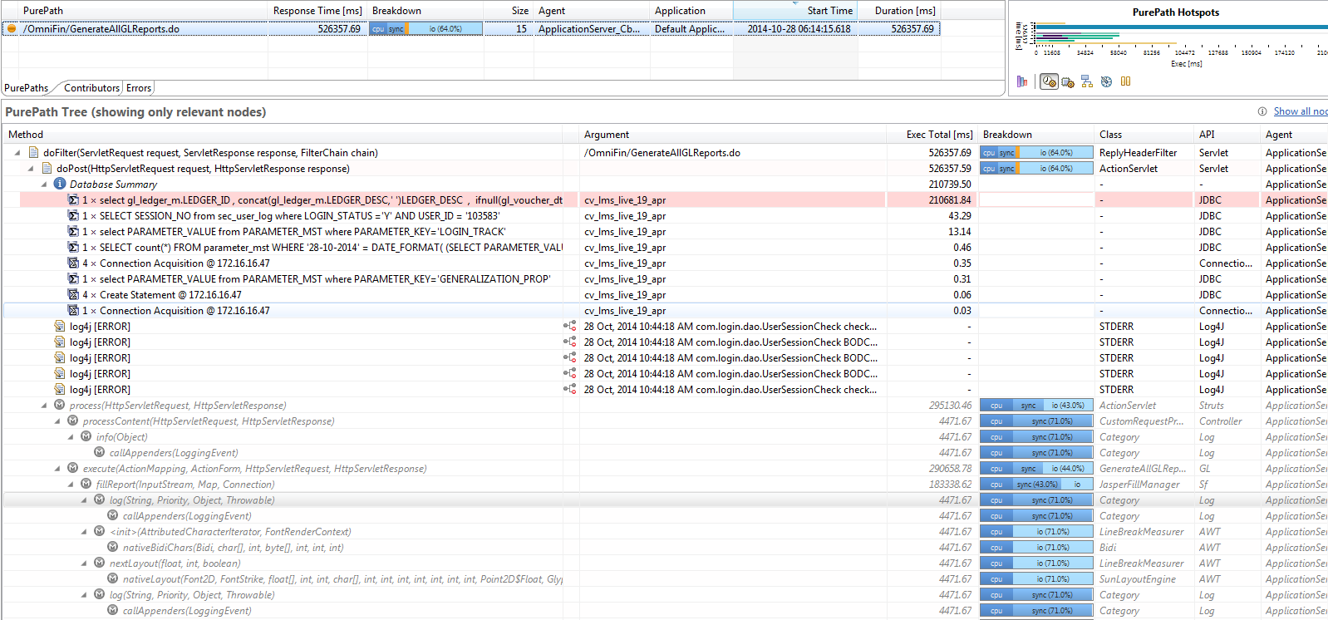
Example from Server-Side Diagnostics
526s to render that report
1 SQL running 210s!
Lots of time spent in logging to Log4J
Lots of time spent in rendering

Slide 54
Online Performance Clinics
Every Other week @
bit.ly/onlineperfclinic

Slide 55
“Share Your PurePath”
bit.ly/sharepurepath
Your Benefits
Free Performance Review
Extended Dynatrace License
My Benefits
More blog material for next year ☺
Gratification that I could help you

Slide 56
Questions and/or Demo
Get Tools: http://ajax.dynatrace.com
YouTube Tutorials: http://bit.ly/dttutorials
Live Q&A Sessions: http://bit.ly/onlineperfclinic
Contact Me: jeff.fynboh@dynatrace.com
Read More: http://blog.dynatrace.com

